Slide 1
UPI Fraud Detection Using MACHINE LEARNING Model

Slide 2
Abstract
Increase in UPI usage for online payments
cases of fraud associated with it are also rising.
Few steps involving UPI transaction process using a Hidden Markov Model (HMM)
how it can be used for the detection of frauds.
An HMM is initially trained for a cardholder.
If a UPI transaction is not accepted by the trained HMM. It is considered to be fraudulent.

Slide 3
ABSTRACT
People can use UPIs for online transactions as it provides an efficient and easy-to-use facility.
With the increase in usage of UPIs, the capacity of UPI misuse has also enhanced.
UPI frauds cause significant financial losses for both UPI holders and financial companies.
In this Project, the main aim is to detect such frauds, including the accessibility of public data, high-class imbalance data, the changes in fraud nature, and high rates of false alarm.
The main focus has been to apply the recent development of Machine Learning algorithms for this purpose.
We have created 5 Algorithms to detection the UPI Fraud and evaluated results Based on that.

Slide 4
Scope of the project
To detect and block from fraud transactions using a UPI.
UPIs play an exploding role in modern economies.
Its popularity and ubiquity have created a fertile ground for fraud, assisted by the cross boarder reach and instantaneous confirmation.
While transactions are growing, the fraud percentages are also on the rise

Slide 5
Introduction
Credit-card-based purchases can be categorized into two types:
1) physical card and
2) virtual card.
In a physical-card based purchase, the cardholder presents his card physically to a merchant for making a payment.
To carry out fraudulent transactions in this kind of purchase, an attacker has to steal the UPI.
If the cardholder does not realize the loss of card, it can lead to a substantial financial loss to the UPI company.
In the second kind of purchase, only some important information about a card (card number, expiration date, secure code) is required to make the payment. Such purchases are normally done on the Internet or over the telephone

Slide 6
LITERATURE SURVEY
TITLE | AUTHOR | MONTH/ YEAR | JOURNAL/ CONFERENCE | EXPLANATION
Random Forest for Credit Card Fraud Detection | Hettiarachchi H.A.C.K. | December 2021 | IEEE | SVM (Support Vector Machine) Small change in data will not affect the model stability. Long training time, lots of memory required.
Credit Card Fraud Detection - Machine Learning methods | Nikhil Jadhav | 2020 | IEEE | Logistic Regression It tells about coefficient size with direction (positive/negative) If (No. of observation< features) than it may lead to over fit.
A Comparative Study of Machine Learning Techniques for Credit Card Fraud Detection Based on Time Variance | Felix G. Hamza-Lup | 2021 | IEEE | Gaussian Naïve Bayes The prediction and training process is fast and gives best result with small data sets.
Credit Card Fraud Detection: A Novel Approach Using Aggregation Strategy and Feedback Mechanism | Mengwei Pang | 2020 | IEEE | K-Neighbor Classification Since it doesn’t require training time new data can easily added to it. Need scaled data. It can’t work with high dimensionality.
A Survey of Credit Card Fraud Detection Techniques: Data and Technique Oriented Perspective. | Heinrich F., Joeres F., Lawonn K. | 221 | IEEE Trans. Vis. Comput. Graphics | Random Forest It uses bagging and ensemble learning as a result it reduces over fitting and improves the accuracy of a model. It is complex in nature.

Slide 7
EXISTING SYSTEM
To detect counterfeit transactions, three machine-learning algorithms were presented and implemented.
There are many measures used to evaluate the performance of classifiers or predictors, such as the Gradient Boost Classifier, Vector Machine, Random Forest, and Decision Tree.
These metrics are either prevalence dependent or prevalence-independent.
Furthermore, these techniques are used in UPI fraud detection mechanisms, and the results of these algorithms have been compared.

Slide 8
PROBLEM DEFINITION
There are lots of issues that make this procedure tough to implement and one of the biggest problems associated with fraud detection is the lack real-world data to perform experiments on.
The reason behind this is the sensitive financial data associated with the fraud that has to be kept confidential for the purpose of customer’s privacy.
There should be a proper means to handle the noise. Noise is the errors that is present in the data, for example, incorrect dates.
This noise in actual data limits the accuracy of generalization that can be achieved, irrespective of how extensive the training set is.

Slide 9
PROPOSED SYSTEM
Various modern techniques like artificial neural network
Different machine learning algorithms are compared, including Auto Encoder, Local Outlier Factor, Kmeans Clustering.
This project uses various algorithm, and neural network which comprises of techniques for finding optimal solution for the problem and implicitly generating the result of the fraudulent transaction.
The main aim is to detect the fraudulent transaction and to develop a method of generating test data.
This algorithm is a heuristic approach used to solve high complexity computational problems.
The implementation of an efficient fraud detection system is imperative for all UPI issuing companies and their clients to minimize their losses.

Slide 10
MODULES
New UPI
Login
Security information
Transaction
Verification

Slide 11
Module Description
New UPI
In this module, the customer gives there information to enroll a new card. The information is all about there contact details. They can create there own login and password for there future use of the card.
Login
In Login Form module presents site visitors with a form with username and password fields. If the user enters a valid username/password combination they will be granted access to additional resources on website. Which additional resources they will have access to can be configured separately.
Security information
In Security information module it will get the information detail and its store’s in database. If the card lost then the Security information module form arise. It has a set of question where the user has to answer the correctly to move to the transaction section. It contain informational privacy and informational self-determination are addressed squarely by the invention affording persons and entities a trusted means to user, secure, search, process, and exchange personal and/or confidential information.

Slide 12
Module Description
Transaction
The method and apparatus for pre-authorizing transactions includes providing a communications device to a vendor and a UPI owner. The UPI owner initiates a UPI transaction by communicating to a UPI number, and storing therein, a distinguishing piece of information that characterizes a specific transaction to be made by an authorized user of the UPI at a later time. The information is accepted as "network data" in the data base only if a correct personal identification code (PIC) is used with the communication. The "network data" will serve to later authorize that specific transaction. The UPI owner or other authorized user can then only make that specific transaction with the UPI. Because the transaction is pre-authorized, the vendor does not need to see or transmit a PIC.
Verification
Verification information is provided with respect to a transaction between an initiating party and a verification-seeking party, the verification information being given by a third, verifying party, based on confidential information in the possession of the initiating party. In verification the process will seeks card number and if the card number is correct the relevant process will be executed. If the number is wrong, mail will be sent to the user saying the card no has been block and he can’t do the further transaction.

Slide 13
Module I/O
New UPI
Given Input- Request from the user for the card.
Expected Output-Assigning an account to requested user.
Login
Given Input- Give username and password of particular user.
Expected Output- Login to user’s account.
Security information
Given Input- Give the security information by answering security questions.
Expected Output-Updation of account with the security details.
Transaction
Given Input- Give the account details and performs transaction.
Expected Output- Updation of database.
Verification
Given Input- Checks with user’s stored details like security answers or hidden details.
Expected Output-If the verification is success, user can perform transaction, else blocks the cards

Slide 14
Hardware Requirements
SYSTEM : Pentium IV 2.4 GHz
HARD DISK : 40 GB
FLOPPY DRIVE : 1.44 MB
MONITOR : 15 VGA colour
MOUSE : Logitech.
RAM : 256 MB

Slide 15
Software Requirements
Operating system :- Windows
Front End : Anaconda iDE
Coding Language : Python
Back-End : - Sql

Slide 16
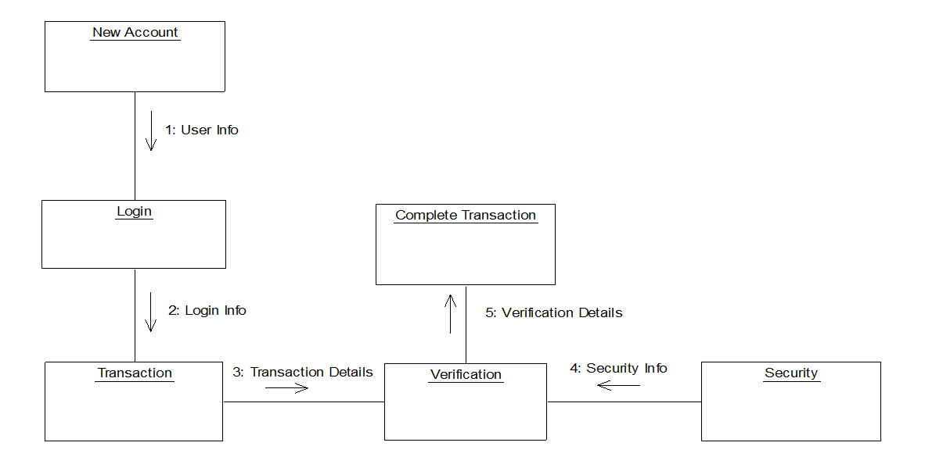
ARCHITECTURE DIAGRAM

Slide 17
Advantages
Highly Security from unauthorized use of UPI
1. Avoids fraud usage of card through online transactions.
2. Detect if card used by others if card lost.

Slide 18
SYSTEM TESTING
To ensure that during operation the system will perform as per specification
To make sure that the system meets user’s requirements during .operation.
To verify that the controls incorporated in the system function as intended.
To make sure when correct inputs are fed to the system, the outputs are correct.
To make sure that during operation, incorrect input, processing and outputs will be deleted.

Slide 19
PERFORMANCE TESTING
Performance test is designed to test the run- time performance of the software within the context of an integrated system. Tests are based on coverage of code statements, branches, paths, conditions.

Slide 20
UNIT TESTING
Testing of individual software components or modules. Typically done by the programmer and not by testers, as it requires detailed knowledge of the internal program design and code.

Slide 21
INTEGRATION TESTING
Testing of integrated modules to verify combined functionality after integration. Modules are typically code modules, individual applications, client and server applications on a network, etc. This type of testing is especially relevant to client/server and distributed systems.

Slide 22
CONCLUSION
UPI fraud becomes a serious concern to the world.
Fraud brings huge financial losses to the world. This urged UPI companies have been invested money to create and develop techniques to reveal and reduce fraud.
The prime goal of this study is to define algorithms that confer the appropriate, and can be adapted by UPI companies for identifying fraudulent transactions more accurately, in less time and cost. Different machine learning algorithms are compared,

Slide 23
REFERENCE
1] K. Sim, V. Gopalkrishnan, A. Zimek, and G. Cong -‘‘A survey on enhanced subspace clustering,’’ Data Mining Knowledge Discovery, vol. 26, no. 2, pp. 332–397, 2019.
2] S. Mcskimming -‘‘Trade-based money laundering: Responding to an emerging threat,’’ Deakin Law Rev, vol. 15, no. 1, 2020.
3] Nitu Kumari, S. Kannan and A. Muthukumaravel - “UPI Fraud Detection Using Genetic-A Survey” published by MiddleEast Journal of Scientific Research , IDOSI Publications, 2014
4] Satvik Vats, Surya Kant Dubey, Naveen Kumar Pandey - “A Tool for Effective Detection of Fraud in UPI System”, published in International Journal of Communication Network Security ISSN: 2231 – 1882, Volume-2
5] S.H. Projects and W. Lovo , ―JMU Scholarly Commons Detecting UPI fraud : An analysis of fraud detection techniques,‖ 2020.

